Slide 1
Variant Calling and Comparison Using GATK HaplotypeCaller and FreeBayes
Kosta Mladenovic 3155/23
Ilija Markovic 3272/23

Slide 2
Introduction
Main objective: Performing variant calling
Comparing the results using HaplotypeCaller VCF as the truth set and FreeBayes VCF as the test set
Report with diagrams and calculate precision, recall, and F-score

Slide 3
Steps of Analysis
Data and Tool Preparation
Download reference genome and BAM file.
Install necessary tools.
Variant Calling
GATK HaplotypeCaller.
FreeBayes.
Comparison of Results
Filter and index VCF files.
Use bcftools and pandas for comparison.
Metric Calculation
Precision, recall, and F-score.

Slide 4
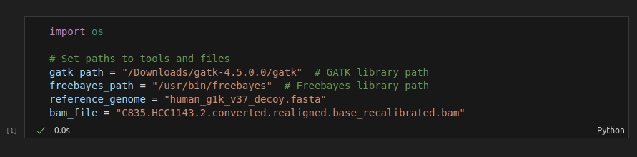
Data and Tool Preparation
Download reference genome human_g1k_v37_decoy.fasta (a reference genome).
Download BAM file C835.HCC1143.2.converted.realigned.base_recalibrated.bam (tumor sample).
Download GATK and FreeBayes libraries.

Slide 5
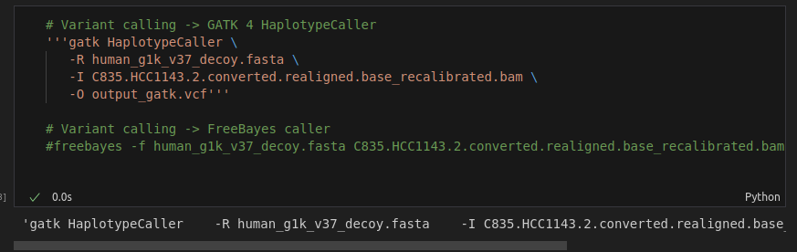
Variant Calling with GATK HaplotypeCaller and FreeeBayes
After downloading necessary .fasta and .bam files, using GATK and FreeBayes libraries, new .vcf files are created.

Slide 6
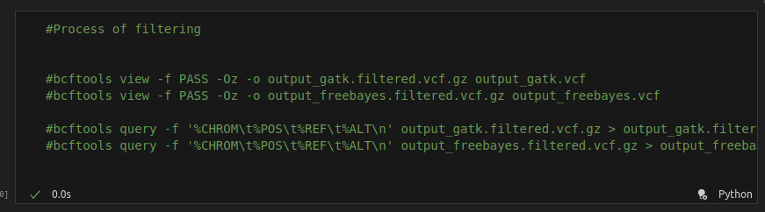
Filtering and Indexing VCF Files
Because .vcf files are large, filtering and indexing are necessary for optimal future work with those files.
Now we have two new .csv files that are easier for compiler to work with.

Slide 7
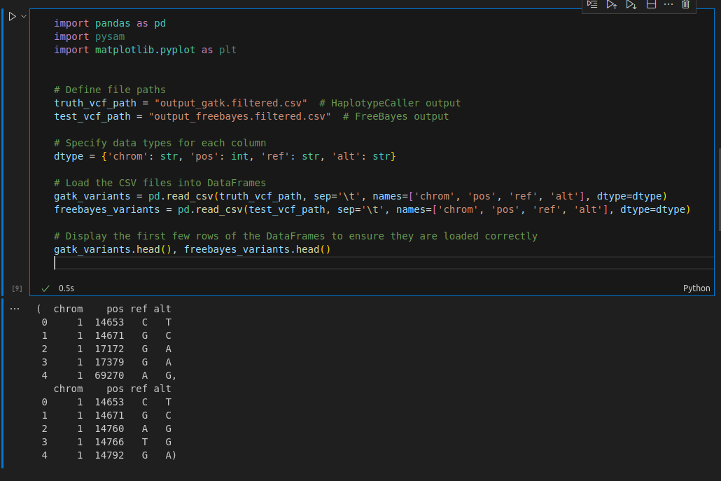
Using pandas
Loading CSV files into pandas so Python can finally work freely.

Slide 8
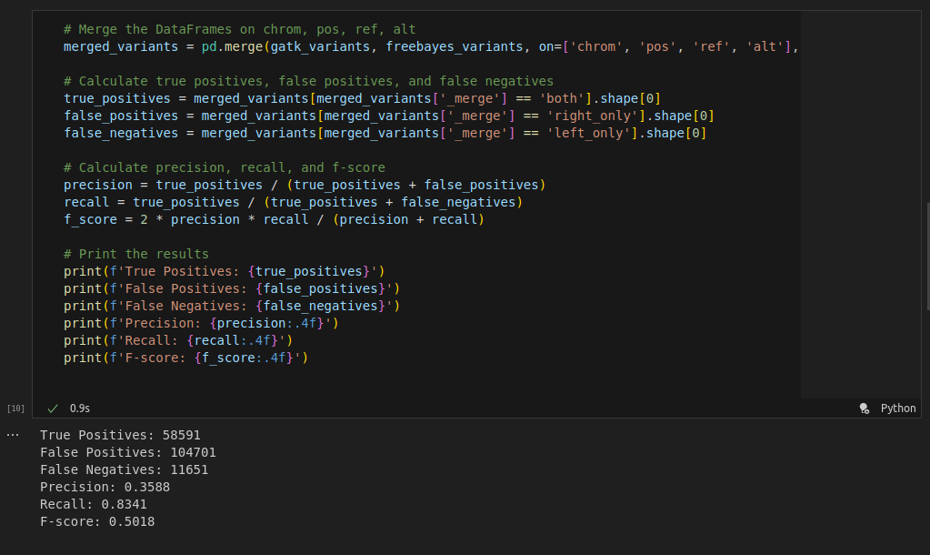
Metric Calculation
Merging DataFrames and calculating true positives, false positives, and false negatives.
Calculating Precision, Recall and F-score alse.

Slide 9
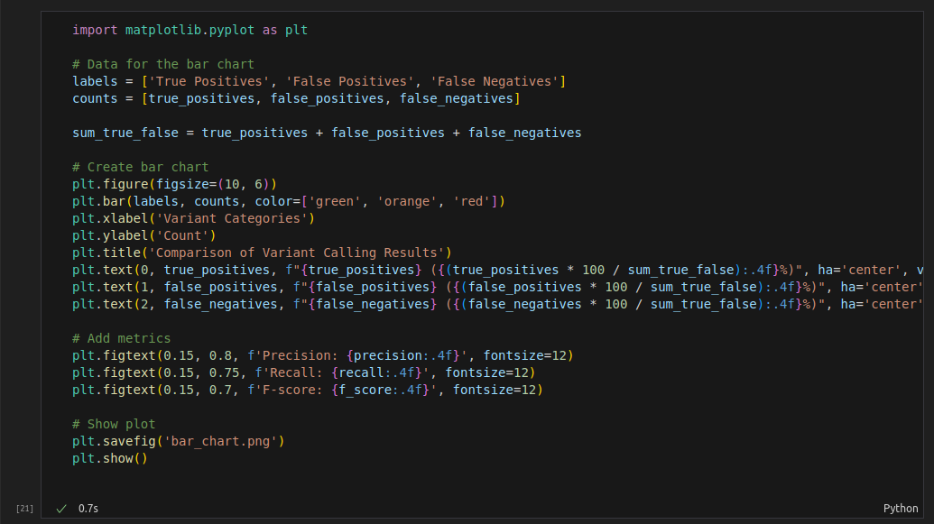
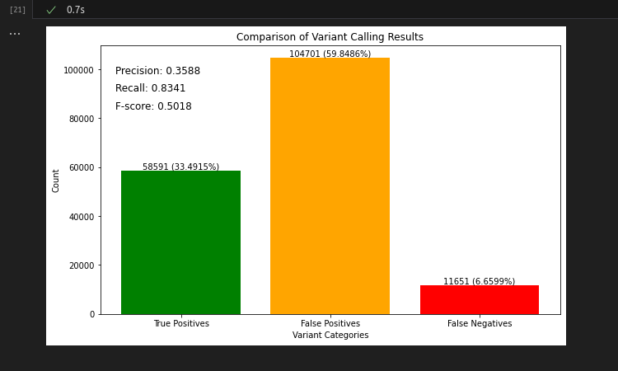
Visualization of Results

Slide 10
Graph Review
Precision: 0.3588
Low precision indicates a high number of false positives (59.8486%).
Recall: 0.8341
High recall shows that most true variants detected by HaplotypeCaller are also detected by FreeBayes (33.4915%).
F-score: 0.5018
Combined metric of precision and recall. The moderate F-score suggests an imbalance between precision and recall.

Slide 11
Evaluation of True Positives
True Positives: 58,591 (33.4915%) - Represents the number of variants correctly identified by both GATK HaplotypeCaller and FreeBayes.
The percentage of true positives (33.4915%) indicates that a significant portion of the true variants detected by the HaplotypeCaller are also detected by FreeBayes.
However, considering that a perfect caller would have a true positive rate close to 100%, this number suggests there is room for improvement (Quality of Data, Parameters and Filters).

Slide 12
Evaluation of False Positives
False Positives: 104,701 (59.8486%) - Represents the number of variants detected by FreeBayes but not by GATK HaplotypeCaller.
A high number of false positives (almost 60%) indicates that FreeBayes is detecting many variants that are not confirmed by HaplotypeCaller.
This can lead to incorrect conclusions and unnecessary follow-up experiments in downstream analyses.
Possible Causes: FreeBayes might be more sensitive, detecting variants that are borderline or noise.

Slide 13
Evaluation of False Negatives
False Negatives: 11,651 (6.6599%) - Represents the number of variants detected by GATK HaplotypeCaller but not by FreeBayes.
A lower number of false negatives (6.6599%) indicates that FreeBayes is missing some variants detected by HaplotypeCaller.
False negatives can result in loss of important genetic information and lead to incomplete conclusions.
Compared to almost 34% True Positives, this amount is relatively O.K.

Slide 14
Conclusion
Results are good, but there is obviously a room for improvement.
Decreasing sensitivity to reduce false positives without increasing false negatives is challenging but necessary.
Adjusting FreeBayes parameters, using additional data quality metrics, and combining results from multiple callers can help.

Slide 15
Thank you for your attention!

